Slide 1
Workflow Optimization
Optimal Job Assignment in a Discrete Event Simulation Environment
Filip Kočovski

Slide 2
Table of Contents

Slide 3

Table of Contents
Introduction
Motivation
Research Questions
Methodology
Discrete Event Simulation
Mixed Integer Linear Programming Policies
Reinforcement Learning Policies
Results
Mixed Integer Linear Programming
Reinforcement Learning
Discussion, Conclusion and Outlook

Slide 4
Introduction

Slide 5

Motivation
Optimize human agents interaction with workflow management systems in order to:
Save costs
Equalize workload fairness
Improve resources usage
Further develop traditional role resolution methods
Solve role resolution in a stochastic fashion

Slide 6

Research Questions
Do traditional mixed integer linear programming based methods for role resolution in workflow management systems exhibit further optimization potential?
Do cutting edge alternative approaches for role resolution in workflow management systems exist?

Slide 7
Methodology

Slide 8
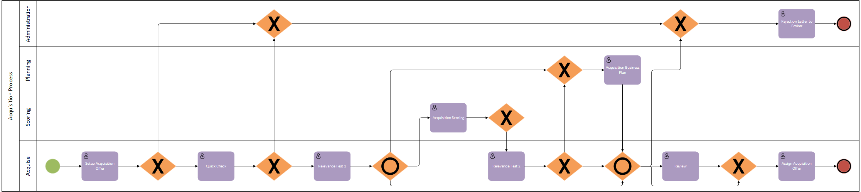
Discrete Event Simulation Environment
Policy based role resolution

Slide 9

Optimization Policies According to Zeng and Zhao (2005)
Pull based
Human actors claim jobs
Push based
Least Loaded Qualified Person (LLQP)
Shared Queue (SQ)
K-Batch
K-Batch-1
1-Batch-1

Slide 10


Policies Legend
Job
Working Slot
Queue
Decision Wall
User
Policy Decision
Formulation

Slide 11
Least Loaded Qualified Person (LLQP)

Slide 12
Shared Queue (SQ)

Slide 13
K-Batch

Slide 14
K-Batch-1

Slide 15
1-Batch-1

Slide 16
Mixed Integer Linear Programming Policies
Minimizing Sequential Assignment (MSA)
Dynamic Minimization of Maximum Task Flowtime (DMF)
Simplified DMF (SDMF)
Extremely Simplified DMF (ESDMF)
Service Time Minimization with ESDMF as Upper Bound (ST)

Slide 17

Minimizing Sequential Assignment (MSA)
$$\min_{}{z}$$
$$\text{subject} \text{to}$$
$$\sum_{i}{x_{ij}=1}$$
$$a_{i}+\sum_{j}{x_{ij}p_{ij}≤z}$$
$$x_{ij}=0 \text{or} x_{ij}=1$$
Maximum flowtime
Each job gets assigned to only 1 user
Busy time + service time
of assigned job
Binary job assignment

Slide 18
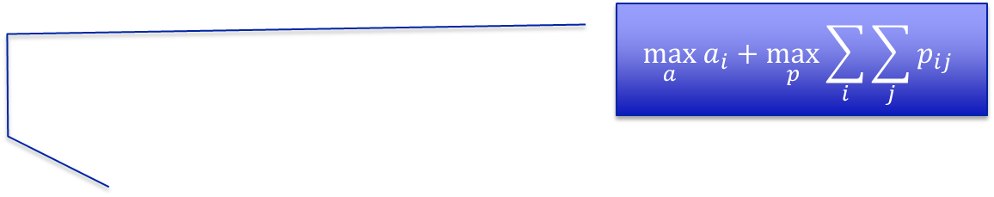
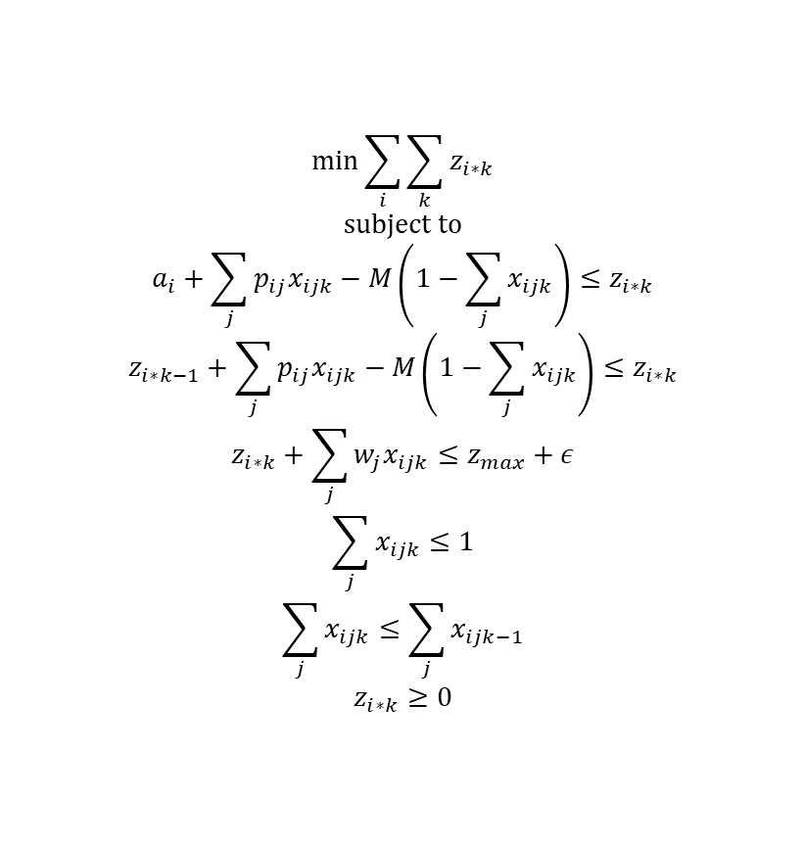
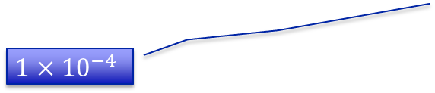
Service Time Minimization with ESDMF as Upper Bound (ST)
$$\max_{a}{a_{i}+\max_{p}{\sum_{i}{\sum_{j}{p_{ij}}}}}$$
$$\min_{}{\sum_{i}{\sum_{k}{z_{i∗k}}}}$$
$$\text{subject} \text{to}$$
$$a_{i}+\sum_{j}{p_{ij}x_{ijk}−M\left(1−\sum_{j}{x_{ijk}}\right)≤z_{i∗k}}$$
$$z_{i∗k−1}+\sum_{j}{p_{ij}x_{ijk}−M\left(1−\sum_{j}{x_{ijk}}\right)≤z_{i∗k}}$$
$$z_{i∗k}+\sum_{j}{w_{j}x_{ijk}≤z_{max}+ε}$$
$$\sum_{j}{x_{ijk}≤1}$$
$$\sum_{j}{x_{ijk}≤\sum_{j}{x_{ijk−1}}}$$
$$z_{i∗k}≥0$$
Minimization constraints
Minimization constraints considering order
Result of ESDMF as upper bound
Each job gets assigned to only 1 user
$$1×{10}^{−4}$$
Each user gets only 1 job considering order
Ensure positivity of minimization objective

Slide 19








Task Flowtime
$$z$$
$$a_{1}$$
$$p_{11}$$
$$p_{12}$$
$$a_{2}$$
$$p_{23}$$
task flowtime
$$z_{1}$$
$$z_{2}$$
MSA
ST

Slide 20

Reinforcement Learning According to Sutton and Barto (2017)
Originates from machine learning
Agents interact with environment to learn
No training sets required
Key concepts:
States
Actions
Rewards

Slide 21
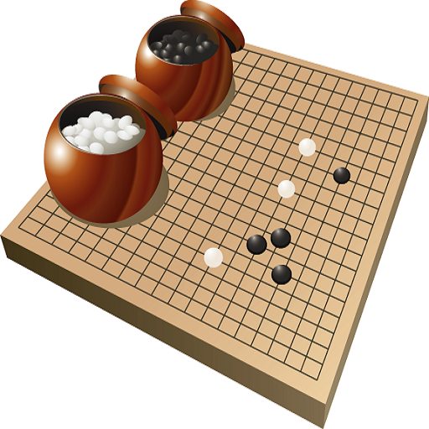

State Space Size
Backgammon: ${10}^{20}$ states
Go: ${10}^{170}$ states
Flying a helicopter: continuous state space

Slide 22

Reinforcement Learning Policies
Value Function Approximation (VFA)
Policy Gradient (PG)
Artificial Neural Networks (ANNs)

Slide 23


Value Function Approximation
Internal weight parameters
$$θ=\left[\begin{matrix}0 & ⋯ & 0 \\ ⋮ & ⋱ & ⋮ \\ 0 & ⋯ & 0\end{matrix}\right]$$
State space
$$S=\left[\begin{matrix}a_{1} & ⋯ & a_{1} \\ ⋮ & ⋱ & ⋮ \\ p_{1,j} & ⋯ & p_{i,j}\end{matrix}\right]$$
Features
$$φ=\left[\begin{matrix}a_{1} & ⋯ & 0 \\ ⋮ & ⋱ & ⋮ \\ p_{1,j} & ⋯ & 0\end{matrix}\right]$$
Approximated values
$$\hat{q}\left(s,a,θ\right)=φ(s,a)⋅θ$$
Stochastic gradient descent
$$∇\hat{q}\left(s,a,θ\right)=φ(s,a)$$
Update weight parameters
$$θ_{t+1}=α{(G}_{t}−\hat{q}(s_{t},a_{t},θ_{t}))∇\hat{q}\left(s_{t},a_{t},θ_{t}\right)$$

Slide 24

Policy Gradient
Instead of maximizing approximated values → use probabilistic choices
$$π\left(a | s,θ\right)\dot{=}\frac{e^{h\left(s,a,θ\right)}}{\sum_{b}{e^{h\left(s,b,θ\right)}}}$$
Preferences
$$h(s,a,θ)\dot{=}φ(s,a)⋅θ$$
Action choice according to weighted preferences
$$\begin{matrix}h(s,a_{1},θ) & … & h(s,a_{i},θ)\end{matrix}$$

Slide 25
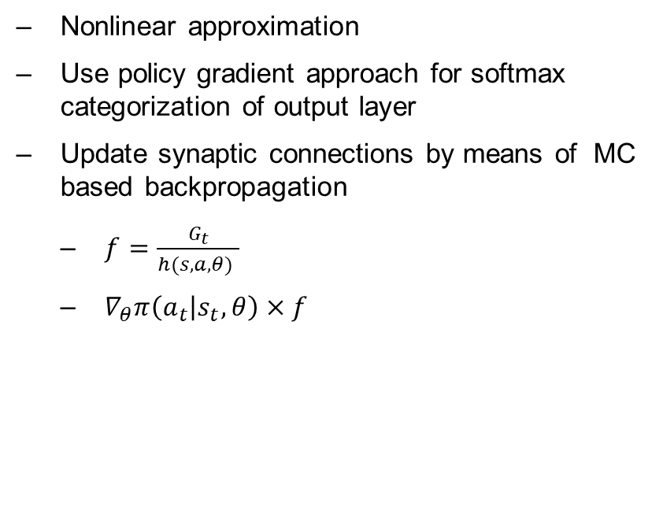
Artificial Neural Networks
Nonlinear approximation
Use policy gradient approach for softmax categorization of output layer
Update synaptic connections by means of MC based backpropagation
$f=\frac{G_{t}}{h(s,a,θ) }$
$∇_{θ}π\left(a_{t} | s_{t},θ\right)×f$

Slide 26
Results

Slide 27


Key Performance Indicators (KPIs)
Lateness: $L_{j}=F−A$
Wait Time: $w_{j}=S−A$
Service Time: $p_{ij}=F−S$
Average System Load: $\overline{l}=\frac{\sum_{i}{l_{i}}}{n}$

Slide 28
Mixed Integer Linear Programming Results
KPI | Speedup
Lateness | 1.23
Wait Time | 4.0
Service Time | 1.1
Average System Load | 1.1

Slide 29
Reinforcement Learning Results
KPI | Speedup
Lateness | 1.2
Wait Time | 2.33
Service Time | 1.1
Average System Load | 1.1

Slide 30
Discussion, Conclusion and Outlook

Slide 31
Optimization Fairness

Slide 32

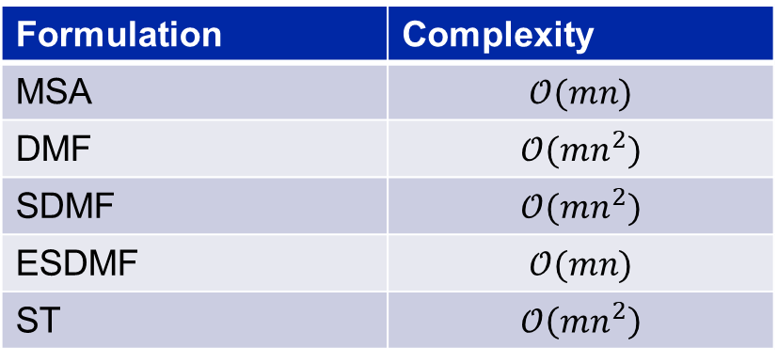
Formulation Complexity
Formulation | Complexity
MSA | $$𝒪(mn)$$
DMF | $$𝒪(mn^{2})$$
SDMF | $$𝒪(mn^{2})$$
ESDMF | $$𝒪(mn)$$
ST | $$𝒪\left(mn^{2}\right)$$
Notes:
m = number of users
n = batch size

Slide 33

MILP Speedup Tradeoff
1.23-fold speedup requires quadratic higher complexity
Solves role resolution in a deterministic way
Business tradeoff:
Higher formulation complexity requirement for marginal speedup
Better use less precise formulation with less formulation complexity requirements?

Slide 34

Reinforcement Learning Alternative
Exact same improvements as ST without high formulation complexity
Solves role resolution in a stochastic way
To be accounted for:
Training sessions requirement for optimal convergence
Domain overfitting

Slide 35

Future Work
Test in operative environments
Recurrent Artificial Neural Networks
Inverse Reinforcement Learning
Apprenticeship Learning

Slide 36

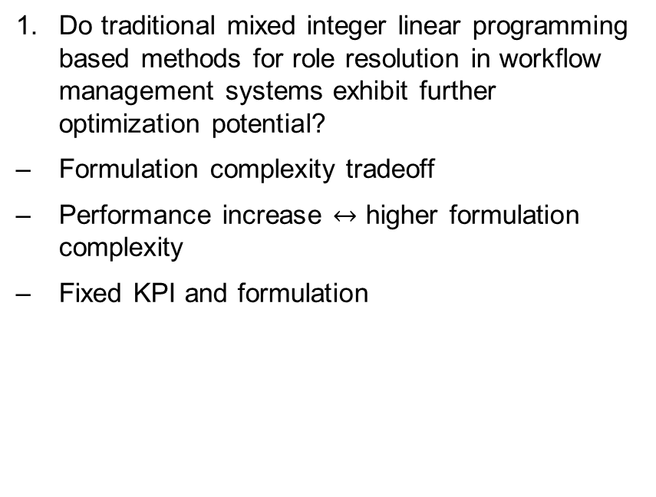
Research Question 1
Do traditional mixed integer linear programming based methods for role resolution in workflow management systems exhibit further optimization potential?
Formulation complexity tradeoff
Performance increase $↔$ higher formulation complexity
Fixed KPI and formulation

Slide 37
Research Question 2
Do cutting edge alternative approaches for role resolution in workflow management systems exist?
Long training sessions for reinforcement learning
Overfitting
Vanishing and exploding gradient problem for deep artificial neural networks

